Slide 1
SAFE START
Stage Two Induction Training
Induction Presentation
Welcome

Slide 2
Introduction Safe Start
Induction is conducted in two stages:
Stage One (Conducted at business location)
Induction DVD;
Basic Overview of Company Procedures & HSQE Arrangements;
Issue Personal Protective Equipment (PPE) and other equipment – if required;
Employee Handbook.
Stage Two (Conducted centrally)
Comprehensive Health, Safety, Quality & Environmental Training (Practical & Theoretical).

Slide 3
Induction Training
SURE START
SAFE START
YOUR START
About J & E Hall
Business Areas
Health & Safety
Employee
Group Structure
Applied Development Centre
H&S at Work Act and H&S Policy
Tools & Equipment
People Centered Management
J & E Hall
Process Systems Marine & Applied(PSMA)
Accident Prevention & Procedures
DSE
Cascade
Company Structure
Safe Systems of Work
Noise & Material Handling
J & E Hall Secure Area
Applied Refrigeration & Service (APRS)
Technical Developments
COSHH & MSDS
Driving & Vehicles
Accreditations & Awards
Product Sales (PS)
Smoking
Working at Height & Housekeeping
Coulstock & Place (RCP)
Signs & Ammonia
PPE & Asbestos
Daikin Applied Service
First Aid, Accident Reporting & Fire
Risk Assessments
Quality & Environment
BS EN ISO 9001
Policy & Procedures
BS EN ISO 14001
Policy & Procedures

Slide 4
Induction Video

Slide 5
Legal Requirements
Health & Safety at Work etc. Act 1974
Section 2(1) - Employers’ General Duty
Duty to ensure ‘so far as is reasonably practicable’, the health, safety and welfare at work of employees and any others who may be affected by the undertaking.
2.2a – Safe plant and systems of work.
2.2b – Safe use, handling, storage and transportation of articles and substances.
2.2c – Information, instruction, training and adequate supervision.
2.2d – Safe place of work and a safe means of access and egress.
2.2e – Safe working environment and adequate welfare facilities.
Section 7 - Duty of Employees at Work
It shall be the duty of every employee whilst at work to:
Take reasonable care of their own health and safety and of any other person who may be affected by their acts or omissions;
Co-operate with their employer so far as is necessary to enable that employer to meet their requirements with regards to any statutory provisions.

Slide 6
Accident Prevention and Procedures
Management seeks to provide a safe workplace and safe working methods. YOU can play your part by working safely.
The prevention of accidents is the concern of everybody;
You must keep your eye on the job and never take risks;
If you study these rules you will go along way towards keeping out of harm;
All near misses must be reported to your Manager;
A system is in operation which requires the reporting by employees of all ACCIDENTS, injuries, diseases and reportable incidents. There will be an immediate investigation to determine the cause of the accident so as to remedy any faults.

Slide 7
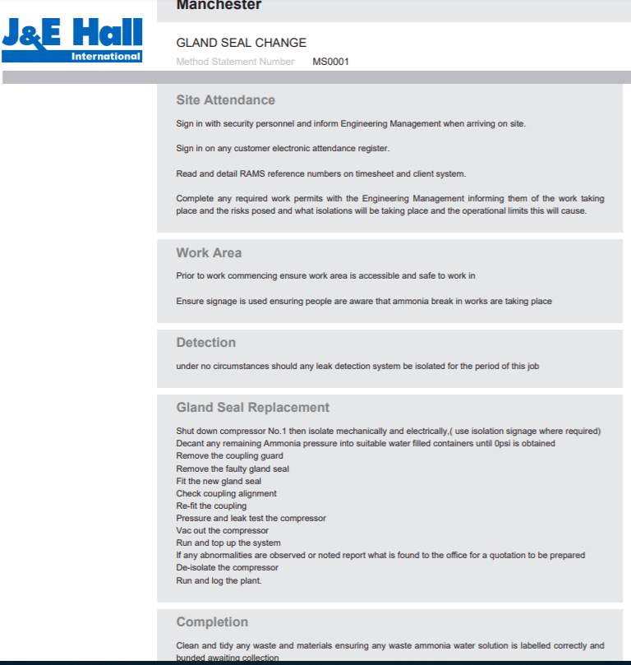
Safe Systems of Work
Safe Working Instructions / Method Statements
To assist all employees to work safely J & E Hall have developed a comprehensive Safe System of Work for all high risk activities;
All relevant Safe Systems of Work Method statements are available on Effective Software;
These are periodically reviewed for effectiveness.

Slide 8
COSHH & SDS
Material Safety Data Sheets.
To assist all employees to work safely J & E Hall have developed a comprehensive range of COSHH assessments;
All relevant COSHH assessments are issued to employees and are also available on the HSQE Web site and Effective Software;
These are periodically reviewed for effectiveness.

Slide 9
Smoking
J & E Hall have a no smoking policy
Adhere to local and site smoking arrangements;
Smoking in company vehicles is prohibited;
“No Smoking” signs are clearly displayed at entrances into our premises and in vehicles.

Slide 10
Drugs and Alcohol
Drugs, Alcohol and substance abuse
Our policy is that the working environment is to be free from the influence of alcohol and drugs:
To ensure your health and safety as well as the health and safety of those with whom you come into contact;
To maintain the efficient and effective operation of our business;
To ensure that our customers receive the best service from us.
You must not:
Report or try to report for work when unfit due to the influence of alcohol, drugs (whether illegal or not) or substance abuse;
Be in possession of alcohol or illicit drugs in the workplace;
Consume alcohol or use illicit drugs or abuse any substance while at work.

Slide 11
Safety Sign’s
Always follow Safety Sign’s instructions.
Warning sign Giving warning of a hazard or danger (e.g. ‘danger: electricity’)
Emergency escape or first-aid sign Giving information on emergency exits, first aid, or rescue facilities (e.g. ‘emergency exit/escape route’;
Mandatory sign Prescribing specific behaviour (e.g. ‘eye protection must be worn’)
Prohibition sign Prohibiting behaviour likely to increase or cause danger (e.g. ‘no access for unauthorised persons’)
Do not take chances, if you are not sure how the job should be done, ask your supervisor or manager.

Slide 12
First Aid
First Aiders
Enable first aid to be given to employees if they are injured or become ill at work;
Take charge when someone is injured or falls ill Call an ambulance if required;
Look after the first aid equipment, e.g. restocking the first aid box.
The purpose of providing first aid is to:
Ensure adequate and appropriate training, equipment, facilities and personnel are provided at each Company facility.

Slide 13
Fire procedures
Preserve life
Sound the alarm at the nearest fire point;
Evacuate the area by the nearest fire exit in an orderly manner (DO NOT stop to collect personal belongings);
Make your way directly to the fire assembly point;
Only tackle a fire if it is safe to do so and you have had training.
Fire Marshal
Responsible for ensuring (where safe) all personnel safely leave the premises;
Ensuring personnel (employees, visitors, contractors) are accounted for at the assembly point;
Liaises directly with the fire brigade;
Employees are to follow all instructions given by the fire marshal, Managers, Supervisors and fire brigade;
Your Manager or Supervisor will carry out their own specific responsibilities in ensuring you follow the fire procedures and they will also liaise with the fire brigade.
All personnel must familiarise themselves with the fire procedures.

Slide 14
Tools and Equipment
Don’t leave tools or equipment lying about;
Defective tools can cause injury to hand or eyes;
Don’t use defective tools, notify your supervisor or manager of any defects found in any of the tools or equipment you might have to use;
All power tools and extension cables MUST be portable appliance tested in accordance to company procedure or client or contract requirements;
Visual inspection should be carried out before work commences;
Only select appropriate tools or equipment for the job.

Slide 15
Machinery and Electrical Equipment
J & E Hall use a Proactive Maintenance System
Proactive maintenance is a preventive maintenance strategy that works to correct the root causes of failure and avoid breakdowns caused by underlying equipment conditions. The purpose of proactive maintenance is to see machine failures as something that can be anticipated and eliminated before they develop.
Before starting up a machine check that all guards are in position and that everybody is clear of the machine;
DO NOT oil or clean any machinery whilst in operation or remove any guards unless authorised to do so;
DO NOT wear rings, neckties or loose clothing around machinery;
DO NOT try to fix, alter or adjust any machinery unless, correctly trained and authorised to do so;
Report any defects to the machine or any safety devices missing to your supervisor or manager at once;
All portable appliances are tested in accordance with company defined schedules;
Report any damage real or suspected to your supervisor or manager;
NEVER USE compressed air to clean down your clothes as serious injury can be caused by even a small direct pressure on the body;
Always use safety glasses when using the air-line, to prevent particles entering your eyes.

Slide 16
Display Screen Equipment (DSE)
Display Screen Equipment (DSE) is included in the Health and Safety Regulation (1992) to protect workers from health risks when working with laptops, PCs, smartphones and tablets.
People who habitually use DSE should be trained in how to minimise risks. A DSE assessment will be conducted for all “users” (more than 2 hours per day).
DSE assessments will be completed online through effective software.

Slide 17
Noise
Employers are required to assess the noise levels to which their employees are exposed.
Scheduled Assessments are conducted to ascertain noise levels and ear protection will be provided
where applicable (80dBA) + (85dBA);
You have a duty to use personal ear protectors when required;
Remember – noise induced hearing damage is irreversible;
Once you’ve lost your hearing, it’s gone forever.

Slide 18
Material Handling
Legislation requires employers to risk assess the manual handling activities to protect employees:
Avoid – The need for hazardous manual handling (SFARP);
Access – The risk of injury from any hazardous manual handling that can’t be avoided;
Reduce – The risk of injury from hazardous manual handling (SFARP).
Employees have the following responsibilities:
To follow appropriate systems of work laid down for their safety;
Make proper use of work equipment provided for their safety;
Co-operate with their employer on health and safety matters;
Inform the employer if they have identified any hazardous handling activities;
Take care to ensure that their activities do not put others at risk.

Slide 19
Lifting Equipment & Fork lift Trucks
Generally the regulations require that lifting equipment provided for us to work is:
Strong and stable enough for the particular use and marked to indicate safe working loads;
Positioned and installed to minimise any risk;
Used safely i.e. the work planned is organised and performed by a competent person;
Subject to ongoing through examination and, where appropriate, inspection by competent people;
NO UNAUTHORISED persons will be allowed to drive or operate fork lift trucks;
Special arrangements apply to drivers that work with transport as training and authorisation are required;
Always be aware of fork lift trucks, some are battery powered and run silently.

Slide 20
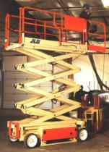
Mobile Elevation Work Platforms
NO UNAUTHORISED persons will be allowed to operate Scissor lift or Genie lift;
Mobile elevating work platforms (MEWPs) offer group fall protection for workers required to carry out work at high level e.g. fitting cables/pipe work at or above ceiling level.

Slide 21
Driving & Vehicles
NO UNAUTHORISED persons will be allowed to drive vehicles on company business.
All employees must adhere to the company vehicle policy.
No Smoking;
Maintenance / Cleanliness;
Loading / Towing;
Licence / Vehicle Checks.
Regular vehicle checks will be arranged by your line manager.
Personnel vehicles used on company business must be taxed, mot’d and insured for company business

Slide 22
Working At Height and House Keeping
YOU must do all that is reasonably practicable to prevent anyone falling.
Employees have the following responsibilities:
To follow appropriate systems of work laid down for their safety;
Make proper use of work equipment provided for their safety;
Co-operate with their employer on health and safety matters;
Informs the employer if they have identify hazardous handling activities;
Take care to ensure that their activities do not put others at risk.

Slide 23
Working At Height and House Keeping
Ladders
Using Portable Metal / Other Ladders;
Ladders must be maintained in good, usable condition at all times;
Footed at all times or tied off at the top;
Used on suitable ground conditions;
Metal ladders cannot be used during electrical work.
Good housekeeping is considered to be the foundation of our safety programme in which everyone must play a part.
There are arrangements for:
The proper storage of clothing, tools and waste;
The provision of adequate space for machinery;
Maintaining a clean workshop, offices and toilets;
Siting and usage of visual display units.

Slide 24
Personal Protective Equipment (PPE)
Every effort is made to provide the most suitable type of personal protective equipment for the job, in consultation with both your manager and Health & Safety function;
Certain areas are designated as “eye safety” and “safety footwear” areas. In these areas eye protection and safety footwear is provided free of charge from the company and should be worn at all times;
Protective clothing, gloves and dust masks etc. may be issued to you for certain operations;
Training – most PPE can be self trained in line with the manufactures instructions;
You must inspect your PPE prior to use. Any loss or damage to equipment should be reported to your supervisor or manager immediately;
CE marking – To provide evidence that it is passed to a standard.
YOUR safety and the safety of OTHERS around you depends on YOU using the equipment provided.

Slide 25
Attending a Site
Engineers or other Personnel are to familiarise themselves with:
Site Induction procedure;
Site emergency procedure system & plant room layout, including associated areas;
First Aid procedures;
Accident reporting;
Local PPE Requirements.

Slide 26
Asbestos
Asbestos survey’s and periodic inspections are carried out:
To ensure the adequate and effective control of asbestos throughout Company premises;
To ensure the risk of exposure is minimised and to comply with legislation;
All asbestos is clearly marked.
It is every Employees responsibility to:
Report any identified or presumed asbestos that has been damaged;
As long as the asbestos is in good condition and it is located somewhere where it can’t be easily damaged then it shouldn’t be a risk to you.

Slide 27
Risk Assessments
Risk Assessments
Every employer shall make a ‘suitable and sufficient’ assessment of risks to the health and safety of:
Employees;
Persons not in his employment;
General public.
Suitable and Sufficient
Should enable the employer to identify and prioritise the measures that need to be taken;
Should identify the significant risks arising out of or as a result of the work activity;
Assessment Review date;
Remember that the required actions progress must be monitored to ensure that the actions are carried out and are effective;
A review should be undertaken following the implementation of the improved controls to assess the effectiveness and to ensure that other new risks have not evolved from these actions;
These are located on Effective Software.

Slide 28
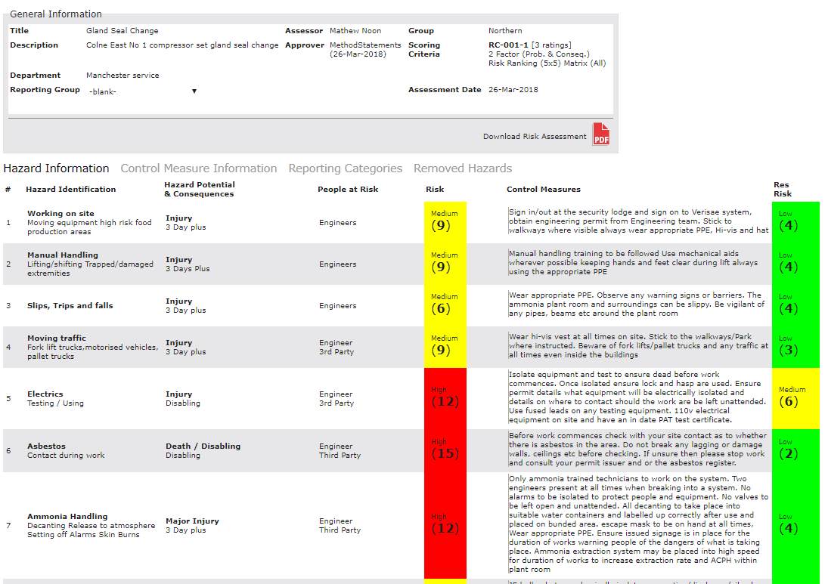
Risk Assessment: Example

Slide 29
Company Policies
Establishes our Commitment to Health and safety, Quality and Environment
Reviewed Annually;
Signed by the Managing Director and Senior Management Team;
Sets out your general approach and objectives (your vision) and the arrangements you have put in place for managing Health and Safety in your company;
It is a Company Specific document that says who does what, when and how.
Notes:
29

Slide 30
BS EN ISO 9001:2015 Quality
What is Quality?
In simple terms, it is the ability to meet all expectations of the customer.
What is the role of BS EN ISO 9001:2015 standards?
These standards are a set of basic rules for quality systems -from concept to implementation-whatever the product or service:
They are a set of rules for manufacturing a product or delivering a service;
They ensure that a supplier has the capability to produce the required goods or services, showing them how to proceed to make sure that what they deliver fully meets customers expectations.

Slide 31
BS EN ISO 14001:2015 Environment
J&E Hall is committed to reducing its environmental impacts and has chosen to adopt the internationally recognised Environmental Management System ISO 14001
You also can help minimize the amount of waste the company produce by:
Printing or copying only what is need;
Re-using paper for scrap;
Placing paper in recycling bins;
Returning ink or toner cartridges back to the supplier for Re-Use;
Good housekeeping;
Re-Use, Re-Cycle where possible;
Only dispose where necessary;
Disposing of waste through the correct waste streams.

Slide 32
BS EN ISO 14001:2015 Environment
BS EN ISO 14001:2015 sets out the criteria for an environmental management system and can be certified to.
BS EN ISO 14001:2015 maps out a framework that J & E Hall Limited follow to maintain an effective environmental management system.

Slide 33
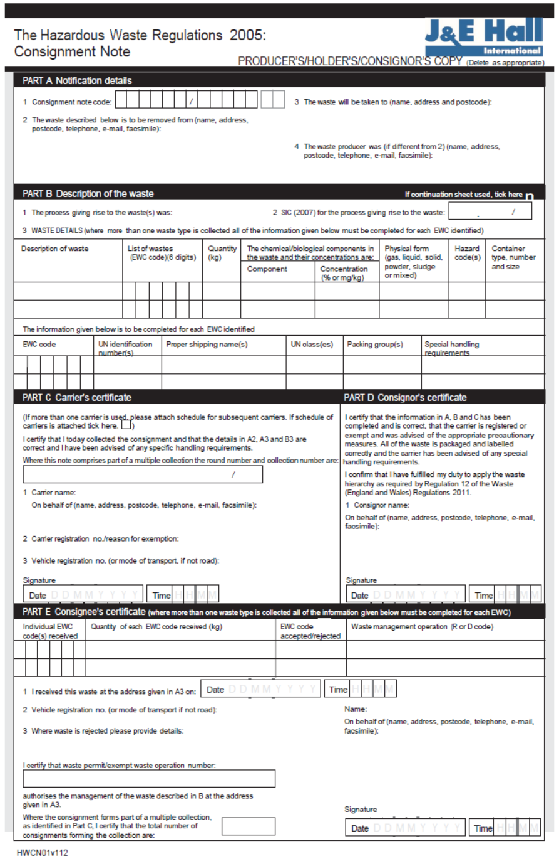
Waste Duty of Care
Waste is stored appropriately;
Only transferred to authorised carriers for disposal;
Carrier is authorised to accept and dispose/transfer of waste;
Waste is disposed/transferred of properly;
Waste must not escape from the holders control;
A transfer note must be completed and accompany every transfer.

Slide 34
Questions
Thank you

