Slide 1


Slide 2

WELCOME
J & E Hall is one of the world’s foremost refrigeration solution providers
We supply and deliver the complete end-to-end
service from design and manufacture to installation, maintenance and on-going support
Total cooling solutions…

Slide 3






COMPANY STRUCTURE
Daikin Applied UK
J & E Hall Ltd
AAF UK Ltd
Applied AC
Refrigeration
Air Filtration
Applied Service
Coulstock & Place

Slide 4





GROUP COMPANIES
Daikin Refrigeration
Daikin India
Reefer Business
Manufacturing capabilities

Slide 5
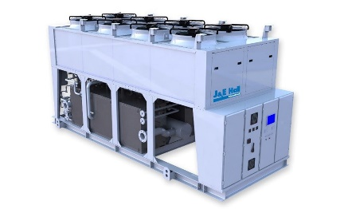
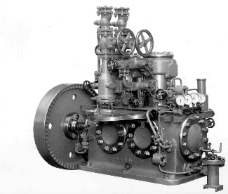
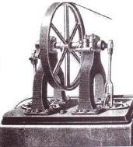
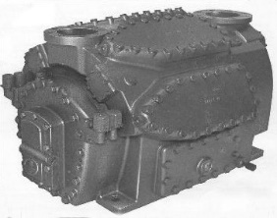

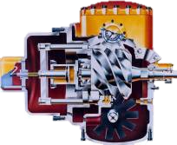
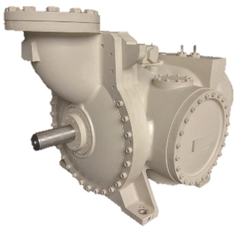
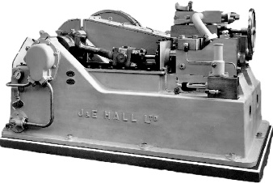
OUR REFRIGERATION HISTORY
First manufactured cold air machines
“Veebloc” compressor launched
Ammonia air cooled chiller launched
First “high speed” ammonia compressor manufactured
2003
1875
1950
1892
2017
1978
7 new open type HallScrew compressors launched
1889
1940
Monobloc range launched
Launched the single screw compressor, the HallScrew
Two stage carbon dioxide compressor designed

Slide 6





OUR MISSION, VISION & VALUES
OUR VALUES
OUR MISSION
OUR VISION
Customer focus
Empowerment
We work together to deliver exceptional service, products and solutions for our customers
To be a leading international
refrigeration engineering company, admired for our employees who provide innovative products and solutions
Our customers are our number one priority. We anticipate their future needs and provide quality solutions, products and services
Using People Centered Management we recognise accomplishment and give opportunities for everyone to develop and progress
Integrity
Flexibility
We are honest, fair and ethical in our dealings. We can be trusted and believed in, and treat all with respect
We are open to change, continually improving and creating new opportunities
Passion
Sustainability
We show pride, enthusiasm and commitment in everything we do
We lead the promotion of environmentally conscious products and solutions

Slide 7


IMPORTANCE OF REFRIGERATION
INSTALLATION
COSTS
THE
LARGEST
CONSUMPTION OF A PLANT’S ENERGY
15%
ENERGY COSTS…
SERVICE & MAINTENANCE COSTS
REFRIGERATION…
20%
65%
RUNNING
COSTS

Slide 8



OUR CUSTOMER FOCUS
Reducing energy consumption
We understand customer needs
A
Increasing efficiency
B
C
Reliability

Slide 9















THE MARKETS WE SERVE
Naval ships
Retail distribution centres
Oil & Gas
Pharmaceutical
Manufacturing
Facilities management
Nuclear
Food processing
Rail
Energy
Brewing &
beverage
Convenience stores
Chemical &
petrochemical
Pubs &
restaurants
Cold store

Slide 10







OUR BUSINESS
PROJECTS
SERVICE
PRODUCTS
SUBSIDIARY
Design, supply and install bespoke refrigeration projects
Refrigeration & air conditioning service & maintenance
Industrial & applied products
New motors & motor rewinds
Commercial products
Engineering solutions
Spares parts & remanufactured compressors
Cable management

Slide 11
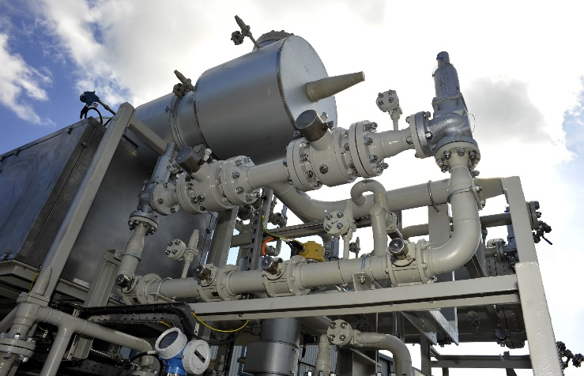
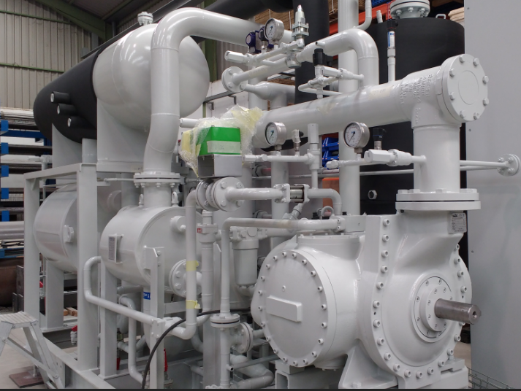

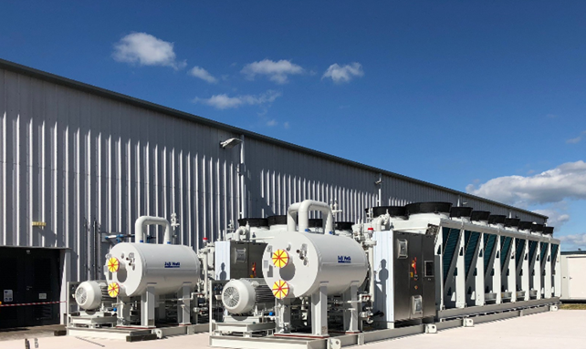
PROJECTS
Design, manufacture and install bespoke refrigeration systems
Refrigeration packages from 20kW to 6,000kW
Cool any type of fluid
Fully integrated mechanical and electrical solutions
Any refrigerant: Hydrocarbons, ammonia, CO2, HFC and HFO
Designed to any international standard
Oil & gas
Chemical
MARKETS SERVED
Petro-
chemical
Marine

Slide 12
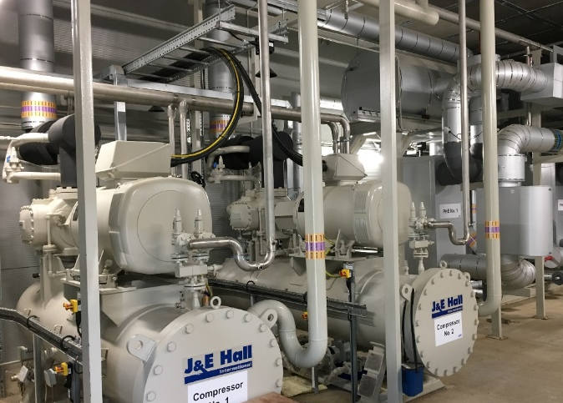


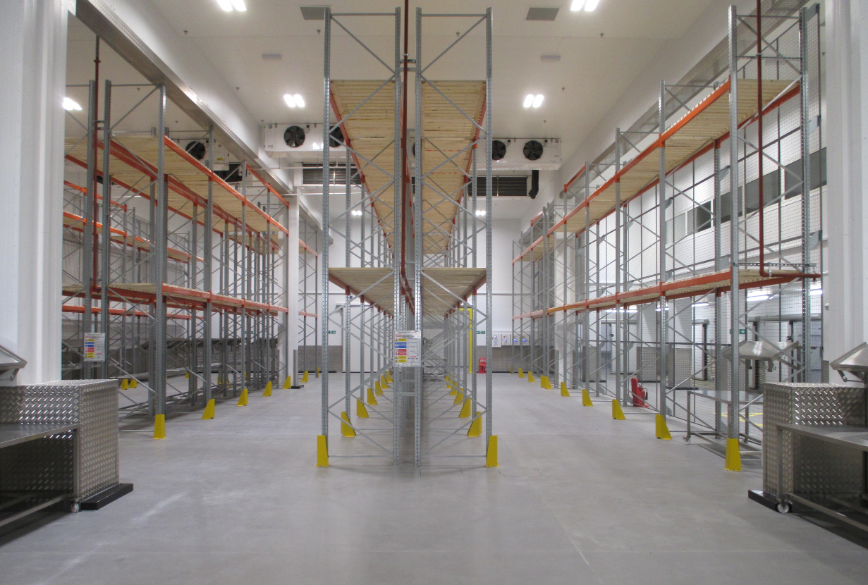


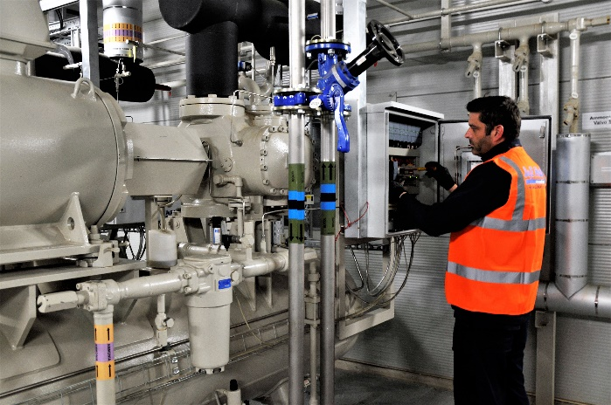

SERVICE
Refrigeration & Air conditioning design, installation, service and maintenance
Nationwide service delivered locally from a network of 9 UK service centres
Support 24/7, 365 days
Planned preventative maintenance
Emergency service
System inspection and audit
National contract expertise
Ammonia risk assessment and training
MARKETS SERVED
Food processing
Brewing & beverage
Retail (RDC)
Cold storage
Facilities management

Slide 13

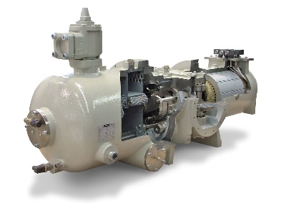


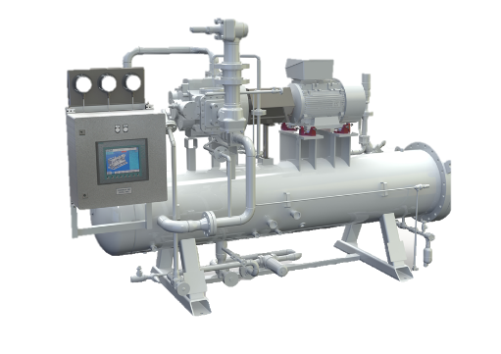


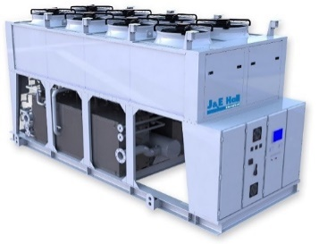

INDUSTRIAL PRODUCTS
HALLSCREW COMPRESSORS
Award winning single screw compressor technology
Semi hermetic and open drive
7 new open drive models added
Complete range displacements from 175 – 2100m³/h
Retail
Brewing & beverage
HALLSCREW COMPRESSOR PACKS
Open drive single screw compressor technology
Complete package with oil management system and controller
MARKETS SERVED
Petro- chemical
Process plant
AQUACHILL
Packaged air cooled chillers
HallScrew open drive compressors
Duties from 219kW to 1,035kW
Ammonia

Slide 14

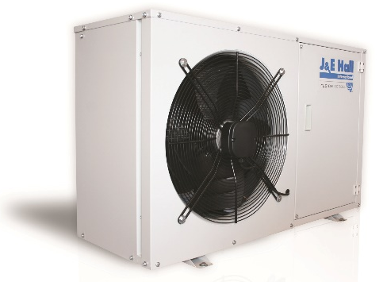




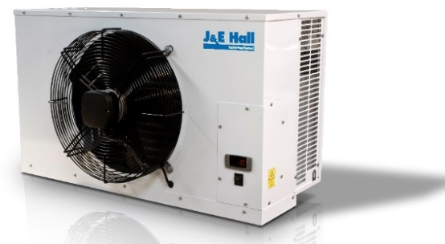


COMMERCIAL PRODUCTS
COMMERCIAL CONDENSING UNITS
UK market leaders
Scroll, digital scroll and reciprocating
Multi refrigerant options
Eco-design complaint
Manufactured in group facilities
Convenience stores
Petrol forecourts
Cold stores
MARKETS SERVED
CELLAR COOLERS
UK market leaders
Brewery specification 6 fins per inch
Electronic control down to 4°C
25m pipe runs
Manufactured in group facilities
Pubs
Restaurants
Prolongs life of fruit, veg, dairy, flowers

Slide 15
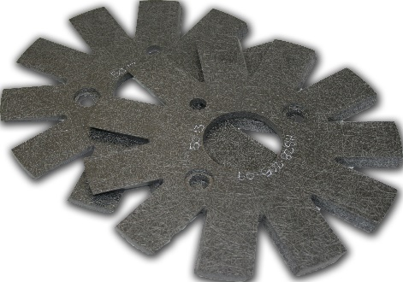
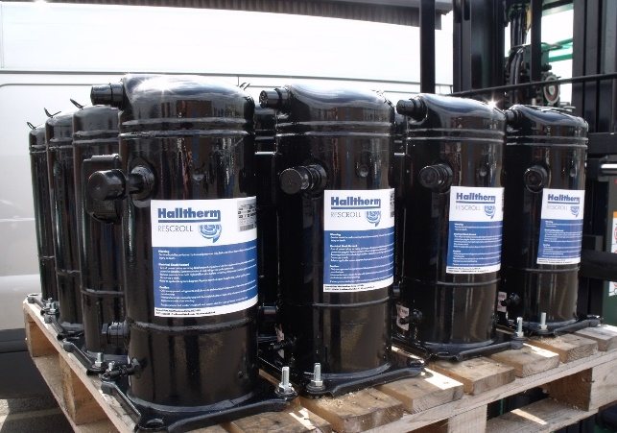
SPARES & REMANUFACTURE
SPARE PARTS
Parts to support J & E Hall industrial and commercial products
Other OEM spares
Associated refrigeration ancillary spares
24hour emergency service
Retail
Brewing & beverage
MARKETS SERVED
Petro- chemical
REMANUFACTURED COMPRESSORS
Industrial compressor remanufacture for all major OEM machines
Screw, reciprocating and piston machines
Unique Rescroll range of remanufactured Copeland scroll compressors
On-site services
Process plant

Slide 16
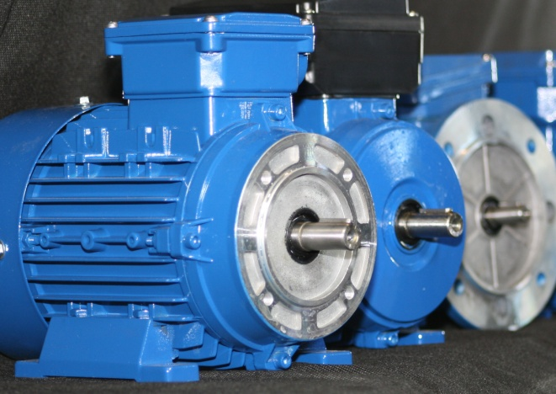
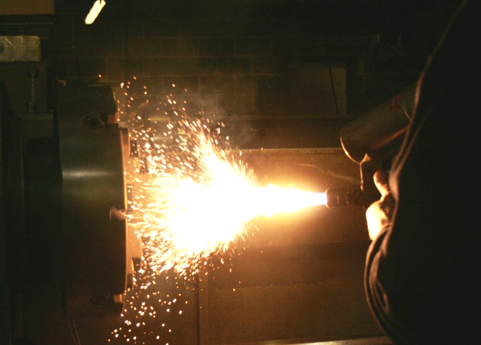


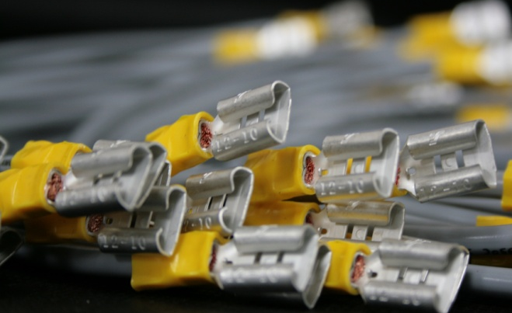

COULSTOCK & PLACE
wholly owned subsidiary of J & E Hall
MARKETS SERVED
NEW MOTORS & MOTOT REWINDS
Supply of new motors 0.18kW to 30kW in 2/4/6 pole
Motor rewinds fractional to 425kW
Rail
ENGINEERING SOLUTIONS
Precision engineering design and manufacture
Refurbishments
Specialist flame spray to refurbish shafts and components
Defence
Medical
Power generation
CABLE MANAGEMENT
Cable harness manufacture
Complete assembly service
Design and build
Automotive

Slide 17
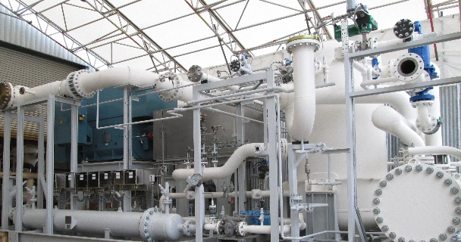

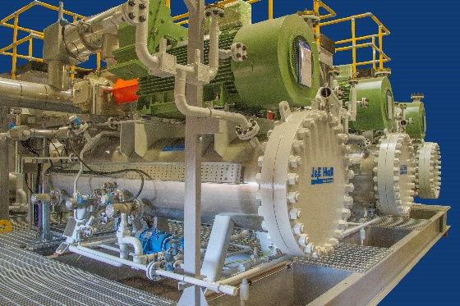
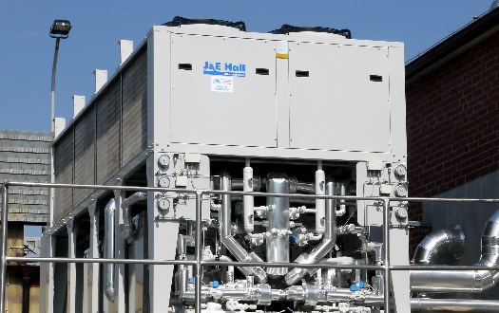
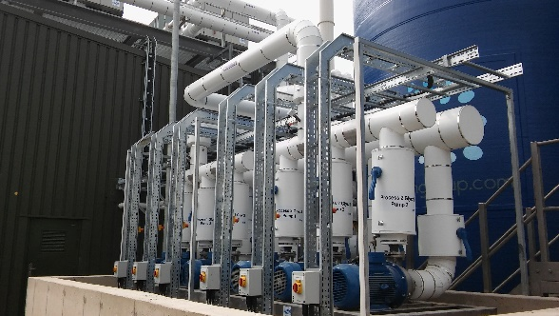
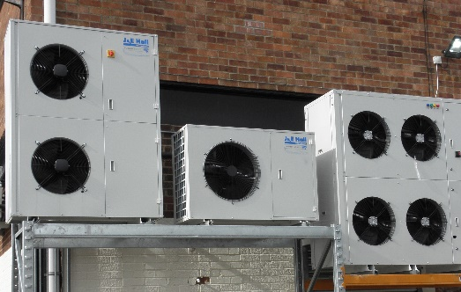
SOME OF OUR SUCCESS STORIES
SULPHAR PLANT REFRIGERATION PACKAGE, KAZAKHSTAN
3 x 3.8MW chillers
R134a Refrigerant
Hazardous area installation
-36°C to +45°C
CONVENIENCE FOOD MANUFACTURER, UK
New installation J & E Hall packs
HSP 202, VSD’s
NH3
1.8MW cooling
TYPICAL PACKAGE, SAUDI ARABIA
Process glycol chilling
1500kW
R134a Refrigerant
Hazardous area installation
-5°C to +50°C
MEAT PROCESSING PLANT, POLAND
Aquachill air cooled chiller
424kW
-3°C to -6°C
CENTRAL COOLING SYSTEM, BEVERAGE MANUFACTURER, UK
2 x 1MW packaged chillers
3 x duty/duty/standby chiller pumps
6 x process pumps
1 x Siemens control system
COMMERCIAL UNITS SUPPLY FOR SUPERMARKET INSTALL, UK
Fusion Scroll condensing units
Cooling for meat counter, chiller rooms and upright freezers

Slide 18
































CUSTOMERS WE’VE WORKED WITH

Slide 19






OUR ACCREDITATIONS

Slide 20




…thank-you
www.jehall.com

